Slide 1
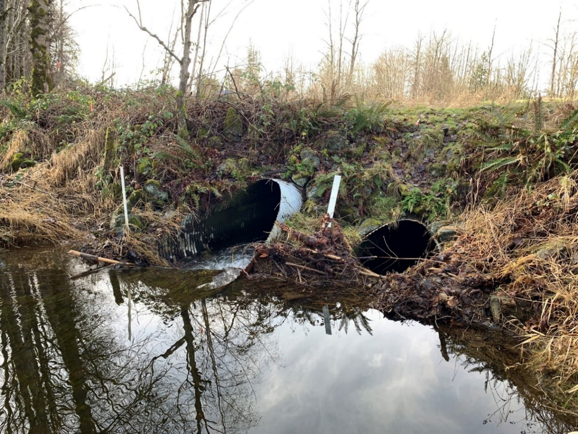
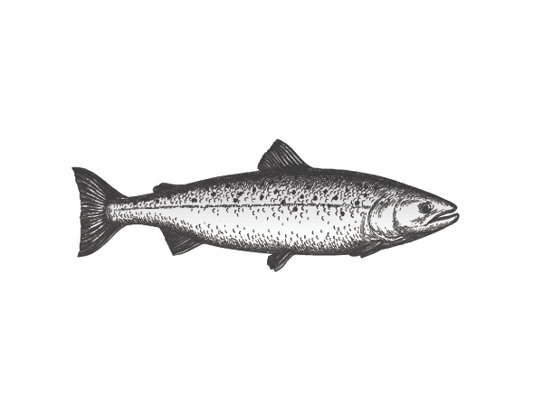
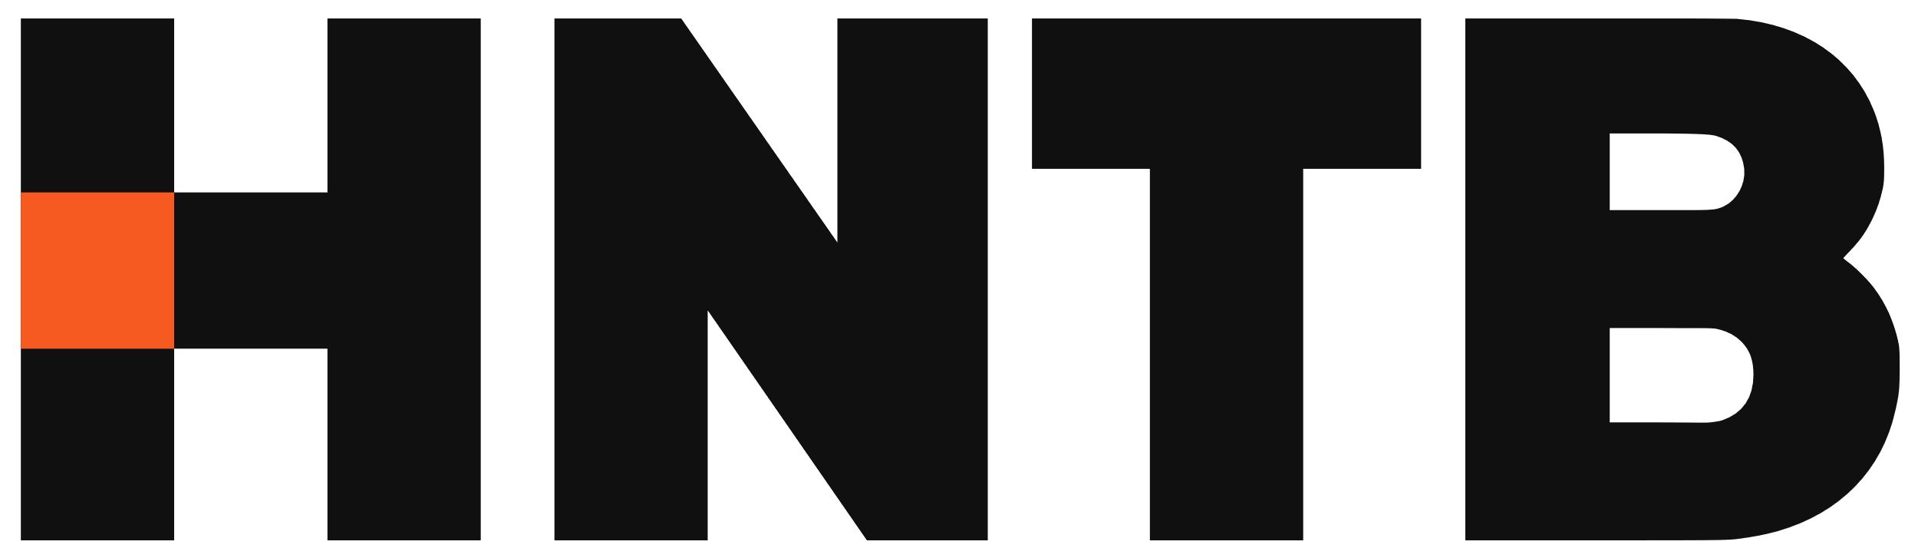

2024 National Hydraulic Engineering Conference, August 27-30, 2024, Biloxi, Mississippi
Challenges in Meeting Local Community Floodplain Management Requirements for Fish Passage and Stream Restoration Projects
Julie Heilman, PE, State Hydraulics Engineer, WSDOT
Henry Hu, PhD and PE, Project Manager, WSDOT Northwest Region GEC
August 29, 2024
NW Region GEC Services

Slide 2
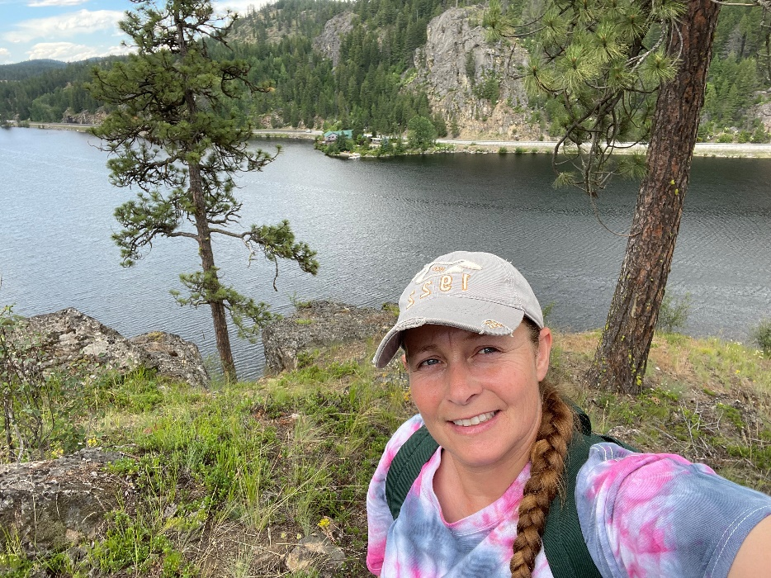




Julie Heilman
State Hydraulics Engineer
HQ Development Division
WSDOT
Hydraulics Section
Hydrology Section
Stormwater Section
Fish Passage Section
Current Duties
24 years at WSDOT
Construction Management
Transportation Engineer
Hydraulics Engineer
B.S. Civil Engineering (WSU)
2 teenagers
1 college kid
Lots of House Projects
Large extended family
Background and Experience
Education
Personal Interests
Notes:
Intro – HQ Hydraulics in Development Division
Oversee 4 programs and work directly with all the region hydraulics engineers
WSDOT for 23 years
Background is in Construction Management, Transportation and Hydraulics Engineering
Those that know me now I graduation from WSU (Go Cougs) General Civil Engineer with emphasis in Transportation and Hydraulic Engineering – go figure.
When I’m not working I juggle the needs of my large extended family, house & yard projects and the need of 2 teenagers and a kid in college ….so I work a lot

Slide 3
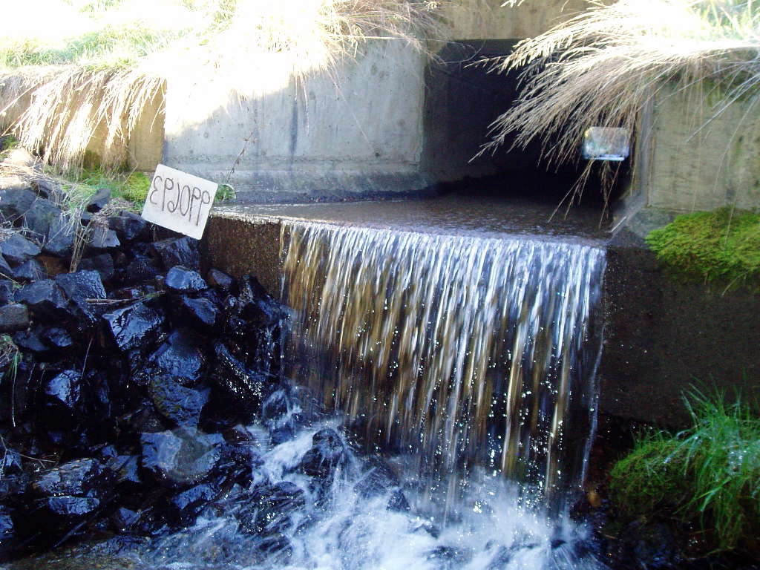
Fish Passage Program Overview
  The scope of the project statewide-Washington’s Highways:
  7,000 + mile long highway system
  4,017 + fish bearing stream crossings
  Approx. 2000 barrier culverts statewide
  Approx. 1500 with significant habitat
    (>200 meters upstream)
Notes:
As I mentioned, we have the largest FP program in the world!
We have many partners that help us with through our Fish Passage Program efforts (resource agencies, Tribes, and consultants) and we can use all the help that we can get because:
WSDOT has over 7000 miles of highway across the entire state
There are around 4000 water crossings over fish bearing streams
And 2000 of those crossings are barriers (that we know about) although that number changes with every season and storm event

Slide 4
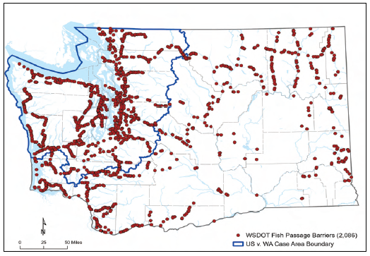
WSDOT Fish Passage Barriers
Total # of barriers = 2086
Current as of 2023

Slide 5
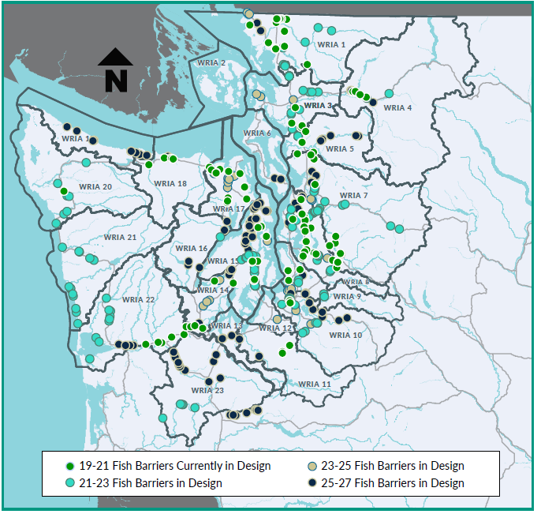
WSDOT 2030 Fish Passage Delivery Plan
Total # of barriers relevant to the injunction = 989
Total # of barriers with significant habitat (> 200 meters)= 806
2030 Delivery Plan ~ 400 barriers
Current as of July 2023
Notes:
Our plan to get us to the 2030 Delivery Plan.
There is a total of 431 barriers currently in our plan. This includes stand alone fish passage projects as well as barriers within larger transportation projects.
The different color dots indicate the biennium most of the design process is taking place.
For example, green dots are currently in design and will go to construction next biennium.
For those of you keeping track, after this summer we have 7 more construction seasons (2023-2029) to complete a couple hundred more sites, or about 50 each year. :D It’s a tall order.
To date:
Under construction 312
Rest design has initiated

Slide 6
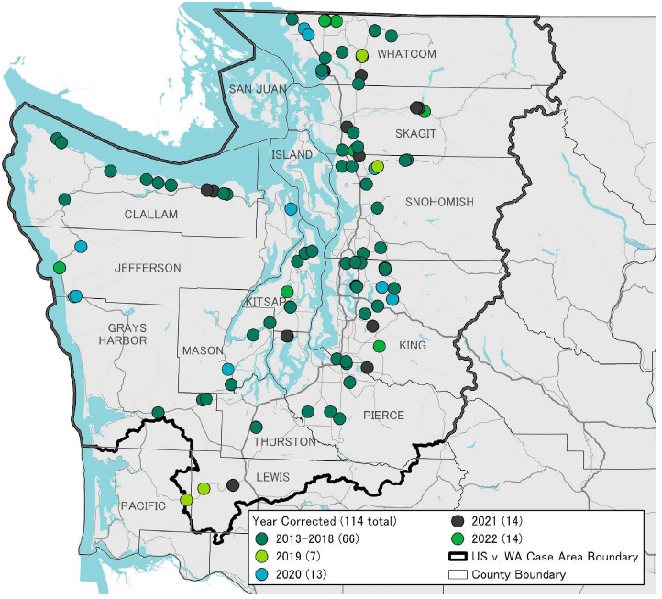
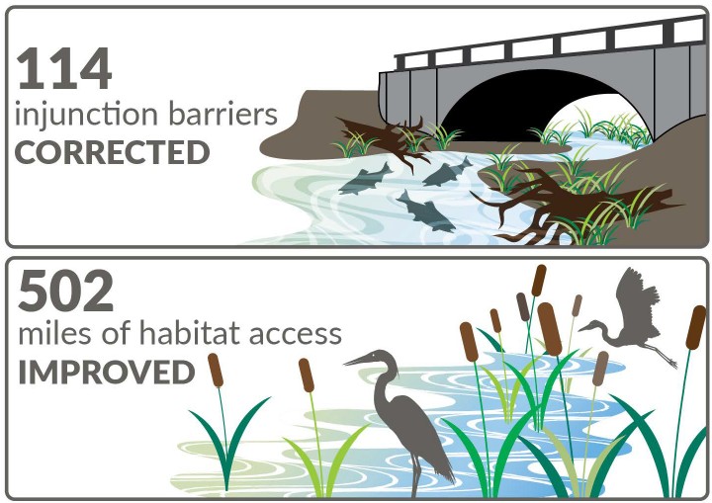
Program Status
  Current program estimate is $7.8 billion
Notes:
In summary of the program status:
As of January 2024
114 corrected barriers
July 2024 corrected 145 injunction barriers, opening 572 miles of potential fish habitat – 50 percent of the total blocked habitat of injunction culverts. We currently have 160 additional sites under construction contract. Once those additional 160 barriers are corrected, WSDOT will have restored access to 70% of blocked potential habitat. With existing funds, we expect to restore access to 75% of blocked potential habitat. The remaining work to get to 90% requires additional funding estimated at $4 billion.
Additional 36 statewide

Slide 7
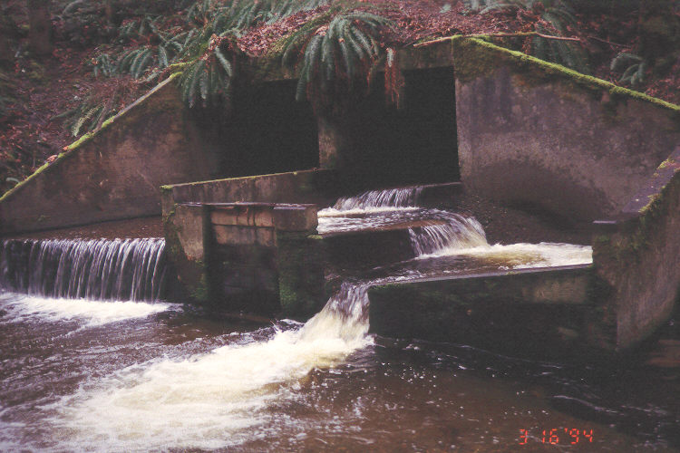
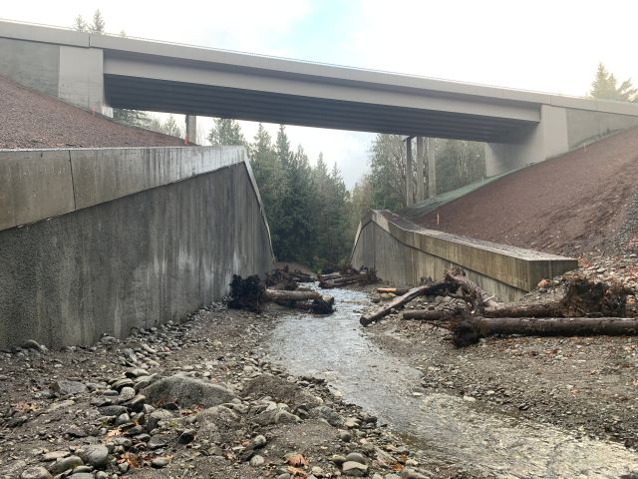
WATER CROSSING DESIGN GOALS
Accommodate increased frequency of severe storms expected in the future
Ensuring structure stability and functionality throughout the life of the asset
Provide access to quality spawning and rearing habitat at all life stages and at all flows
Photo Credit: WSDOT (US101/Sievert Creek)

Slide 8
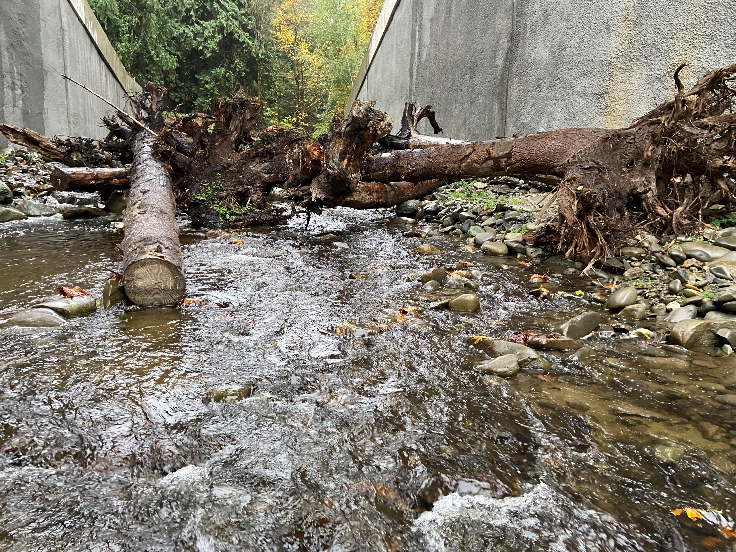
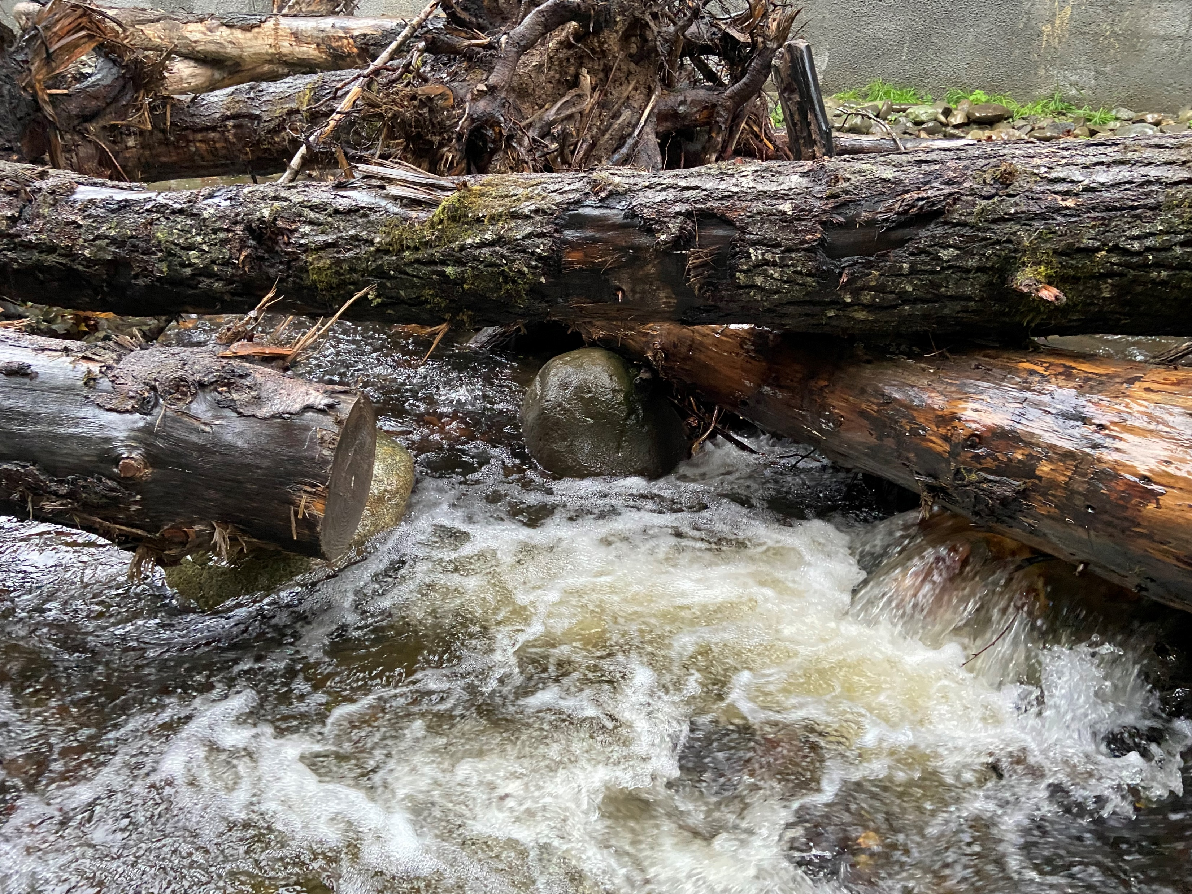
Photo Credit: Henry Hu

Slide 9
WSDOT has made significant progress in designing and constructing a climate resilient fish passable crossing
Modeling using SRH-2D
2080 projected flows
Maintenance Clearance
Scour Certification
Channel Complexity
Floodplain Permit - Remaining challenge for many sites
Notes:
SRH-2D- implemented 2D modeling for all water crossings
Incorporated 2080 projected flows to incorporate projected flow data
Maintenance Clearance –recommendations and requirements depending on restoration and complexity features
Provided more clarity on Long-term Degradation/Aggradation including establishing a minimum scour for 3 sided and bridge crossing structures and our certification program for design consistency
Channel Complexity- expanding the use of LWM and Deformable Grade Control Features through research and monitoring data from experimental features

Slide 10
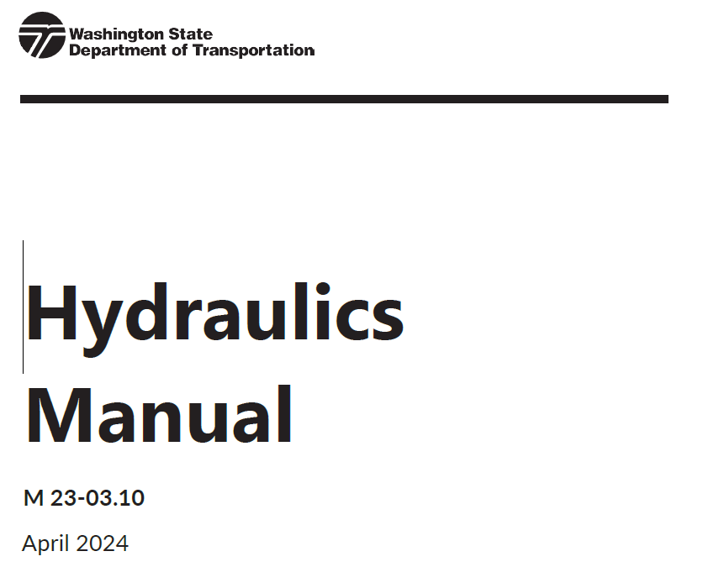
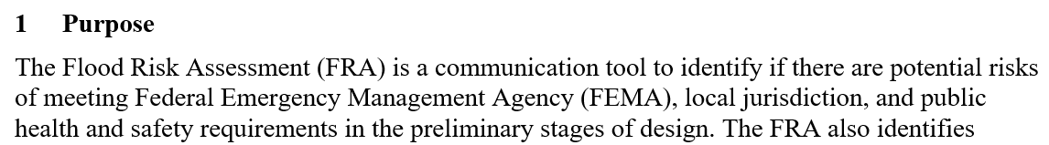
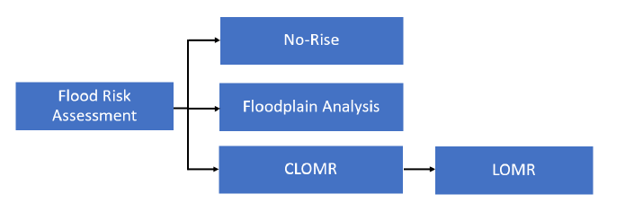
Understanding Local Floodplain Permit
From Flood Risk Assessment Memo Template:
Notes:
Julie to talk about WSDOT policy on flood risk assessment (purposes and type of analysis)
While it takes 8 to 18 months to go through the FEMA CLOMR process, the FEMA CLOMR requirements are well understood.
More challenges on local floodplain permit requirements. Each NFIP community is different. Many exceed FEMA minimum standards. Henry will be presenting this topic in more detail

Slide 11
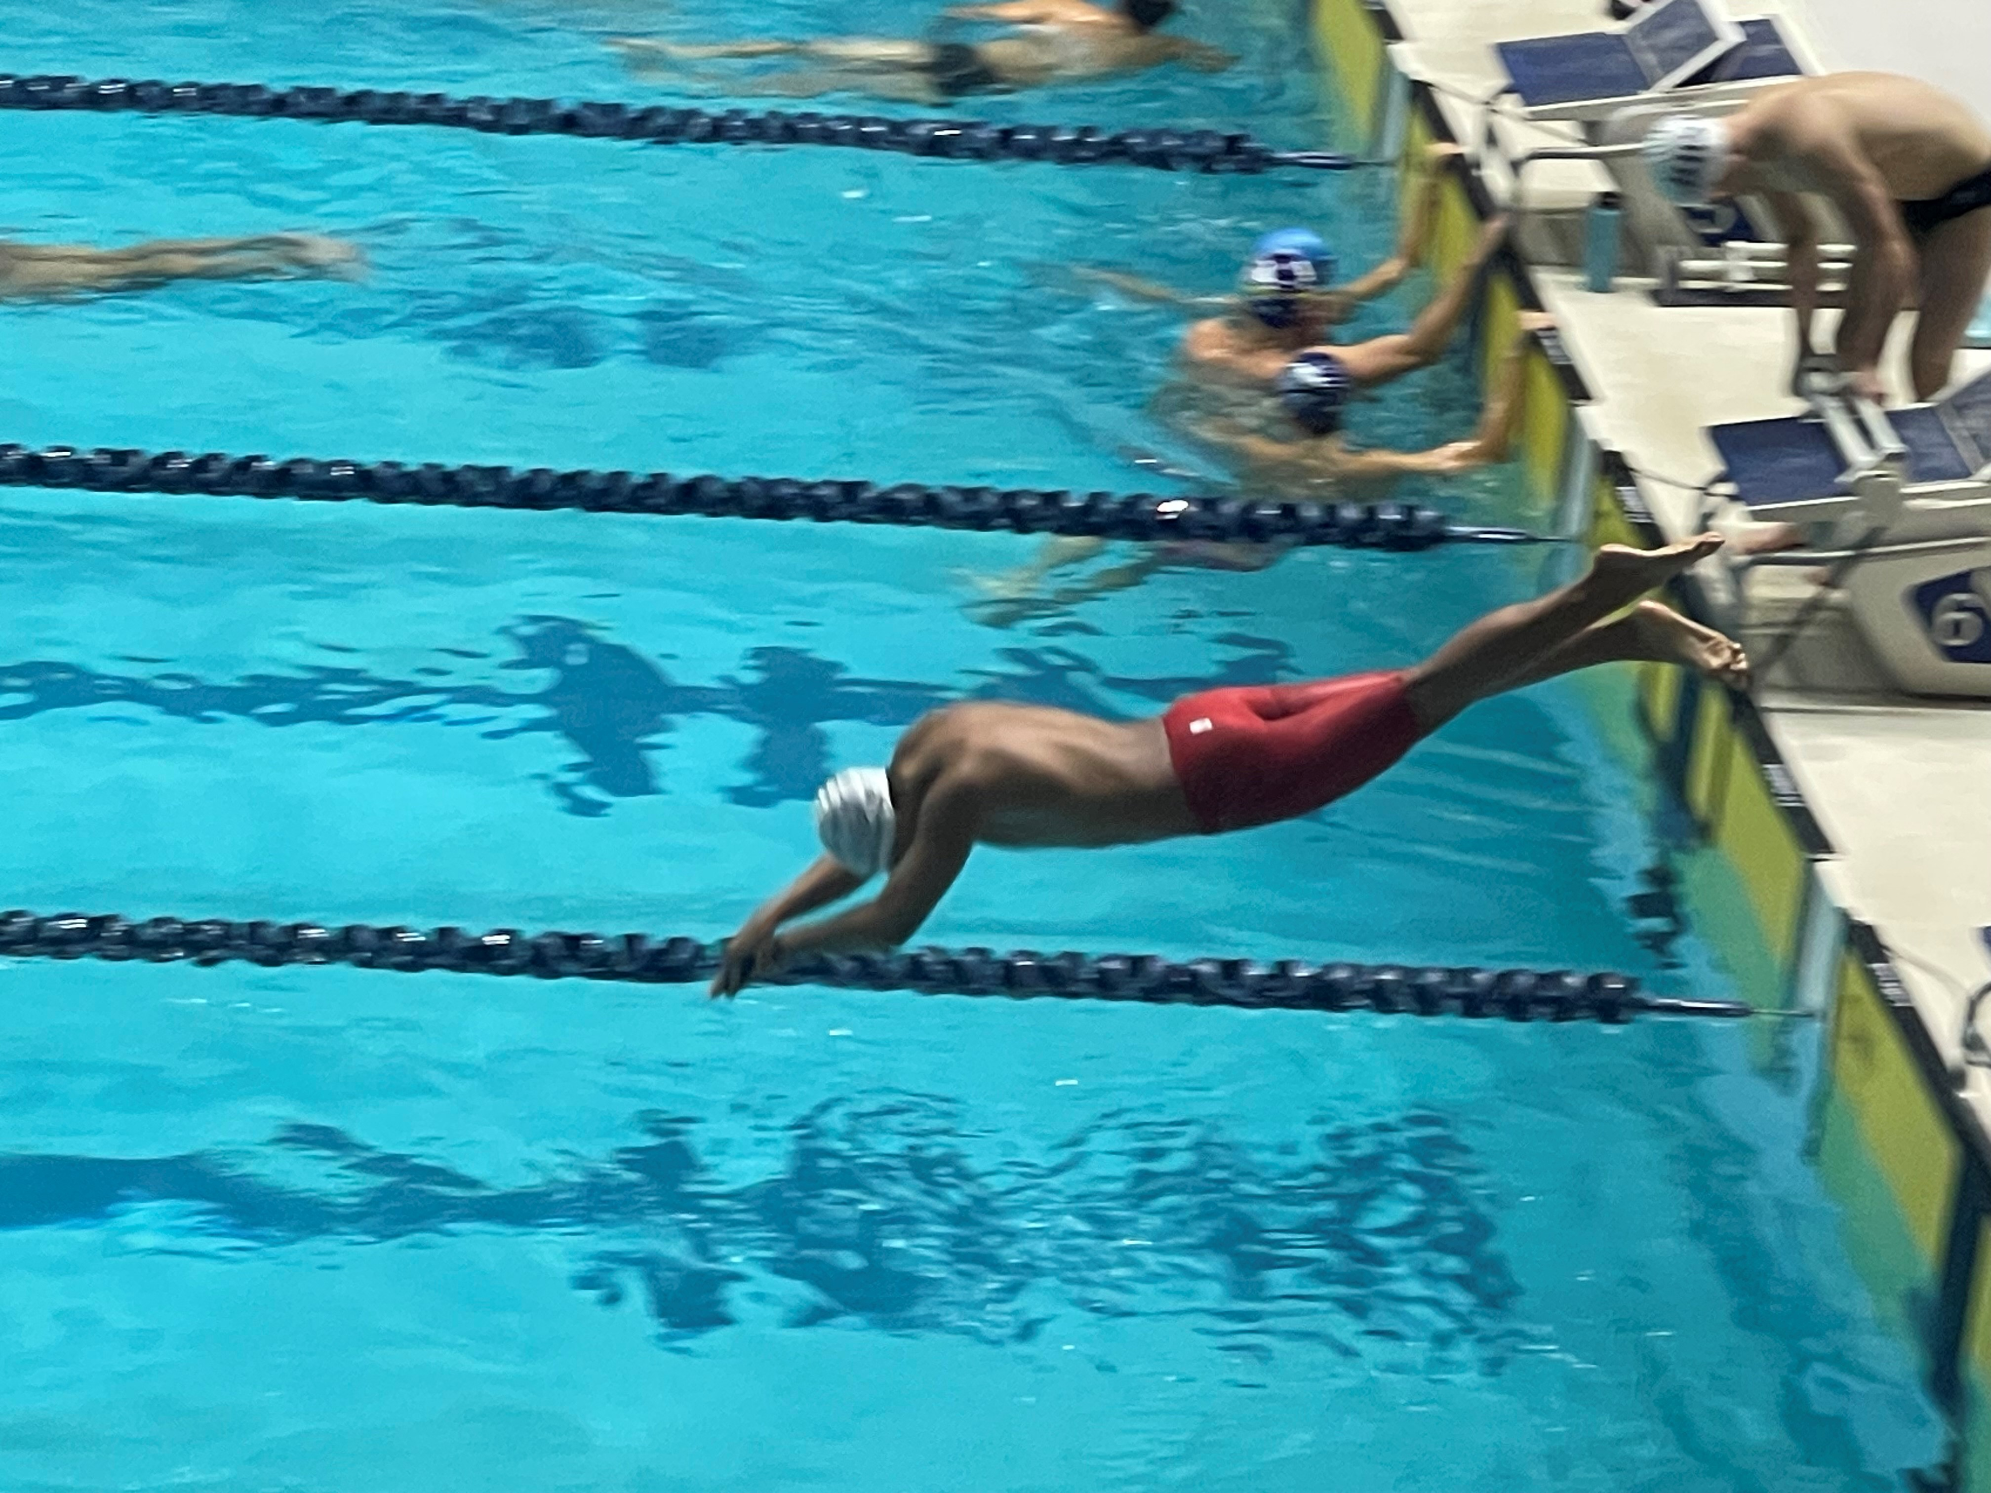
Henry Hu
Sr. Hydraulic Engineer, HNTB, Bellevue Office
WSDOT HQ Hydraulics through Staff Augmentation
Lead NWR GEC Hydraulic Design
Support WSDOT HQ Hydraulics
Support HNTB Hydraulics/Restoration
Current Duties
31 years (7 at University Labs, 24 Consulting)
H&H, Sediment Transport
Numerical Modeling
Fish Passage/Restoration
B.S. Civil Engineering
M.S. River Hydraulics
Ph.D. Hydrodynamics
1 college son
1 high school sophomore
Swim parent since 2013
Background and Experience
Education
Personal Interests

Slide 12
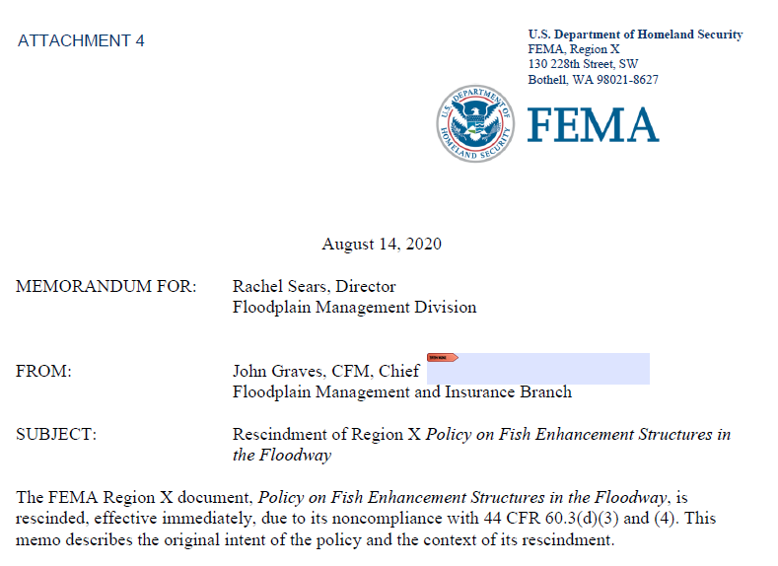
Challenge 1 - FEMA Region X Policy Change – Habitat Restoration in Floodway
FEMA Region 10 Policy on Fish Enhancement Structures in the Floodway
One intent was to support communities by allowing a small rise in the floodway for fish habitat restoration/enhancement projects.
Region 10 rescinded the policy on August 14, 2020

Slide 13
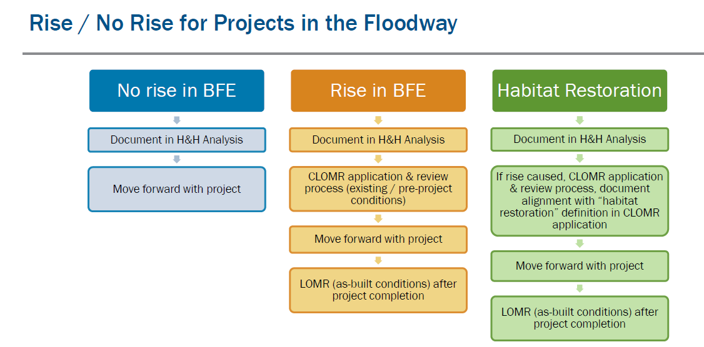
FEMA Region X Policy Change – Habitat Restoration in Floodway
(Source: FEMA)

Slide 14
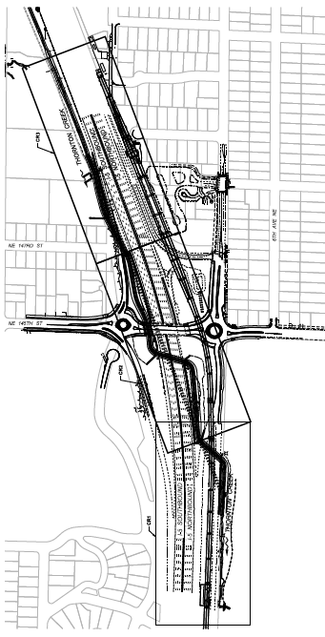
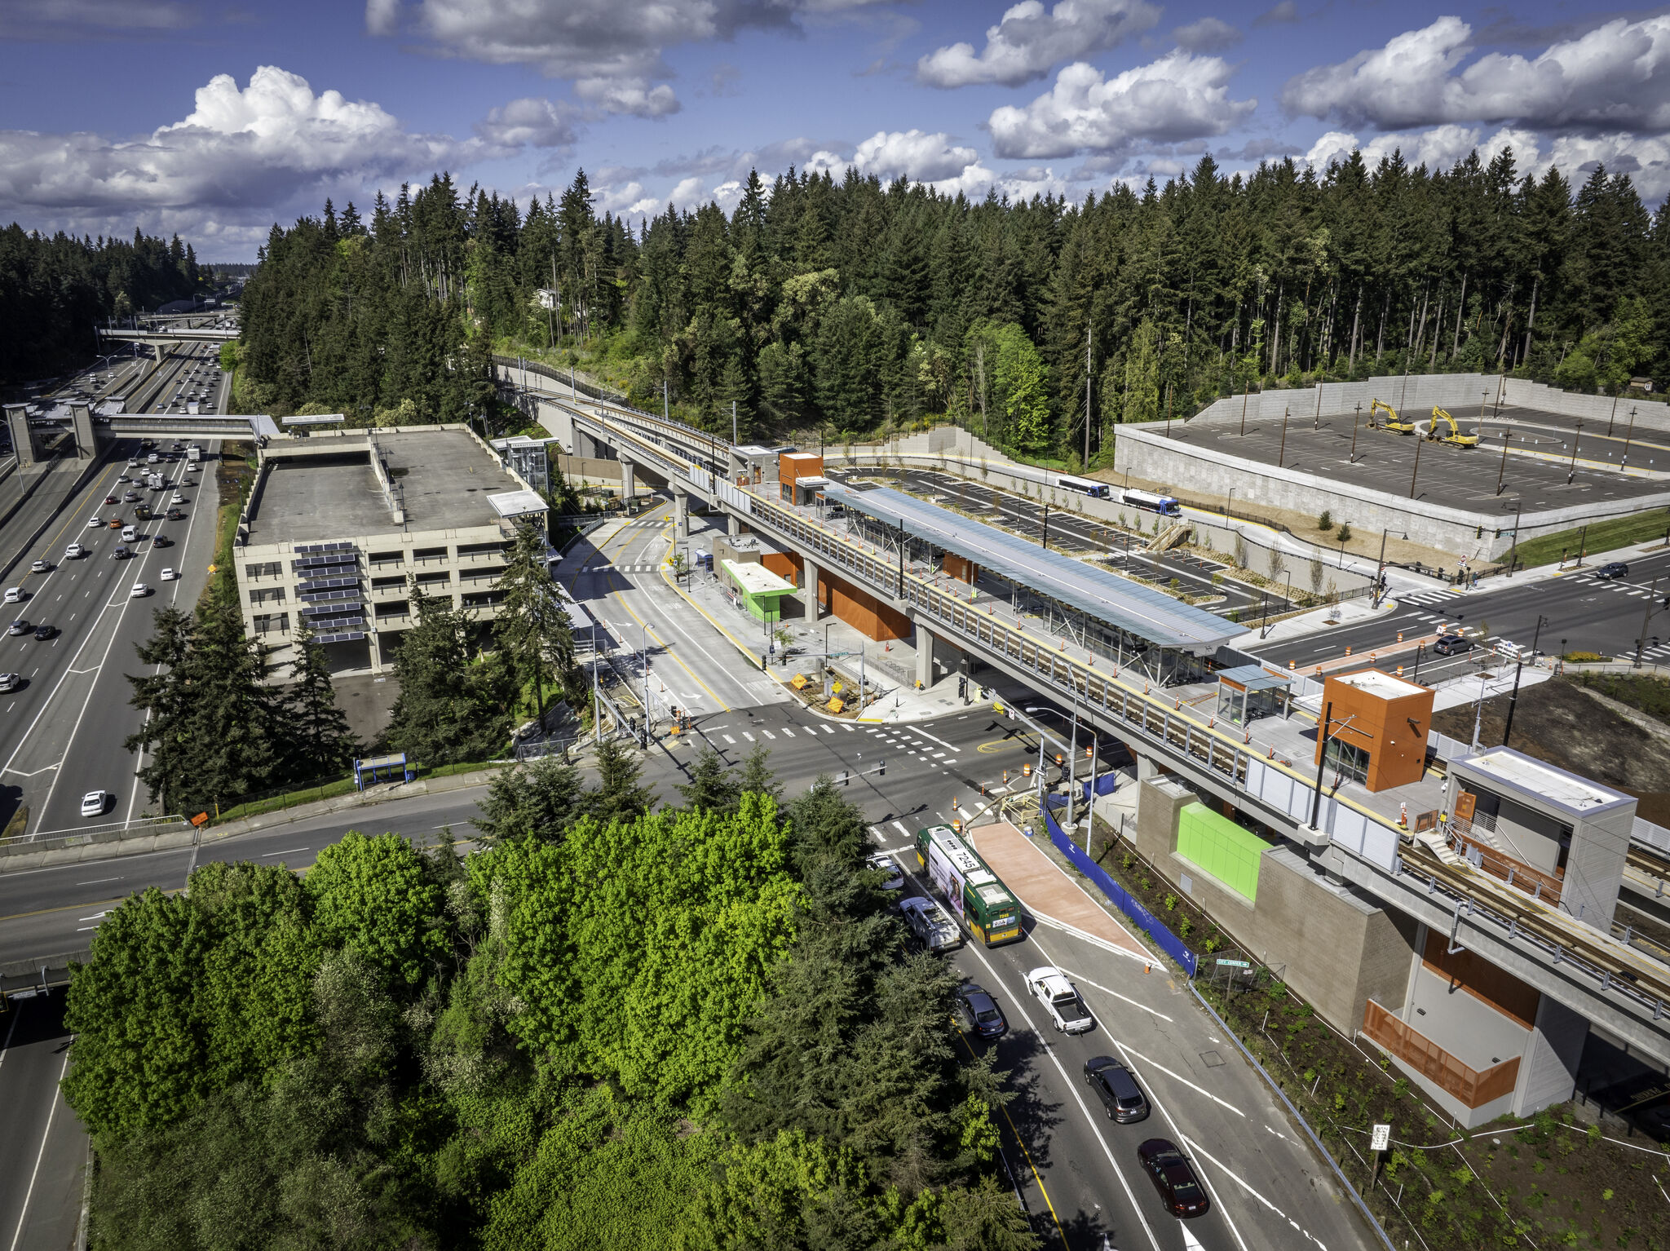
FEMA Region X Policy Change – Habitat Restoration in Floodway
I-5/Thornton Creek

Slide 15
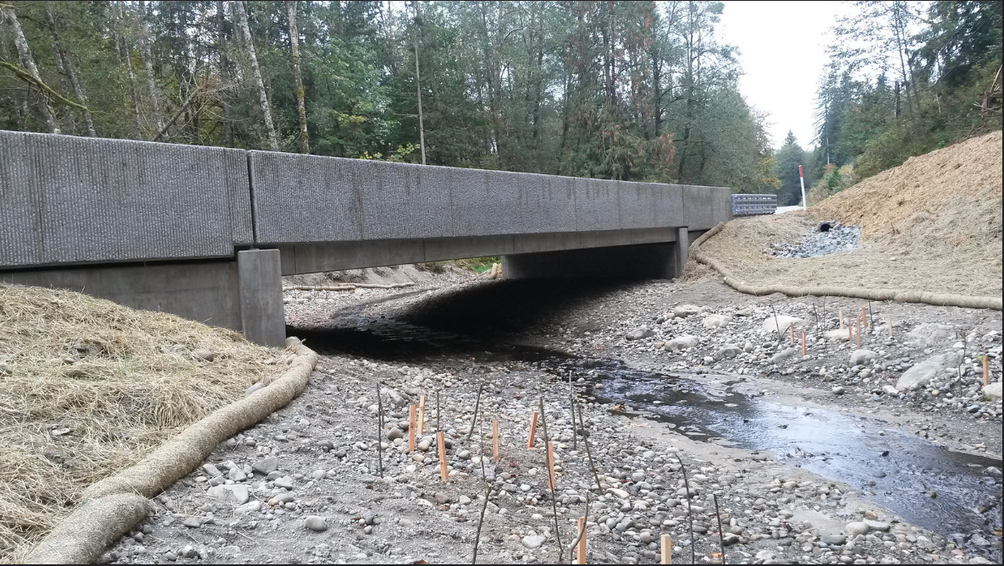
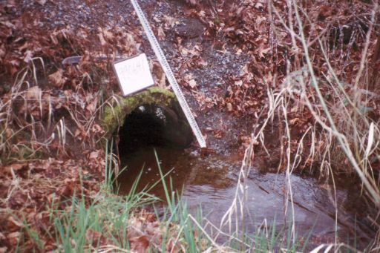
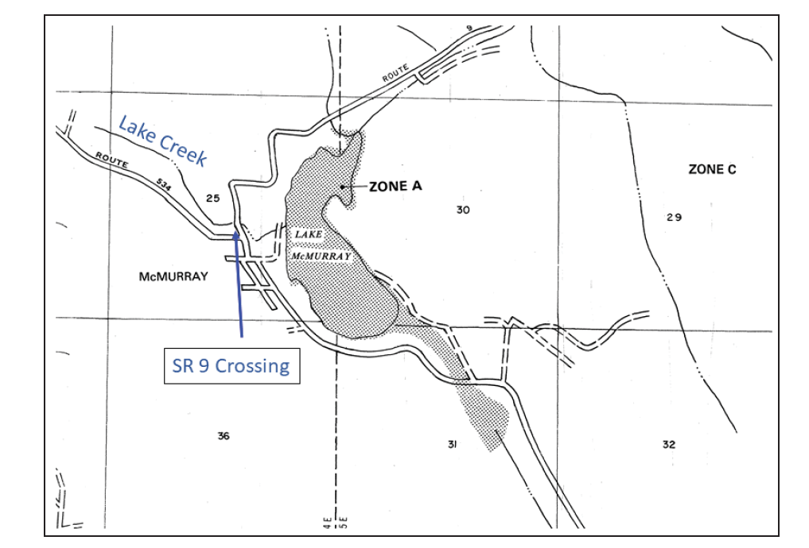
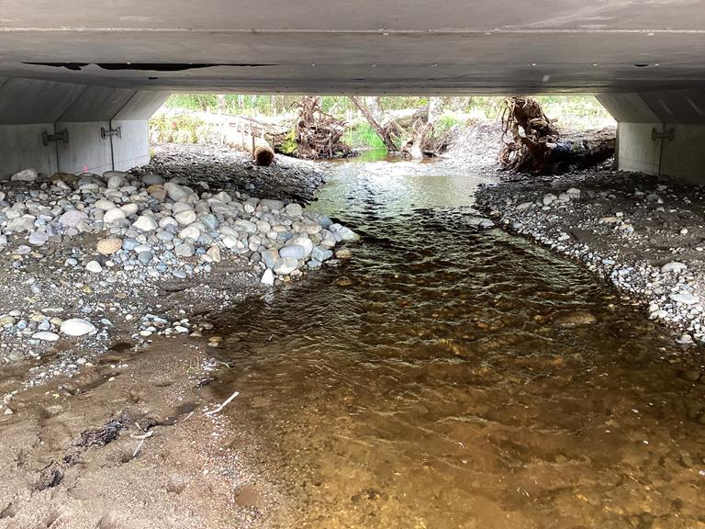
Challenge 2 – Hydraulic Impacts from Undersized Culverts to Larger Fish Passable Structures
(Photo Source: WSDOT)

Slide 16
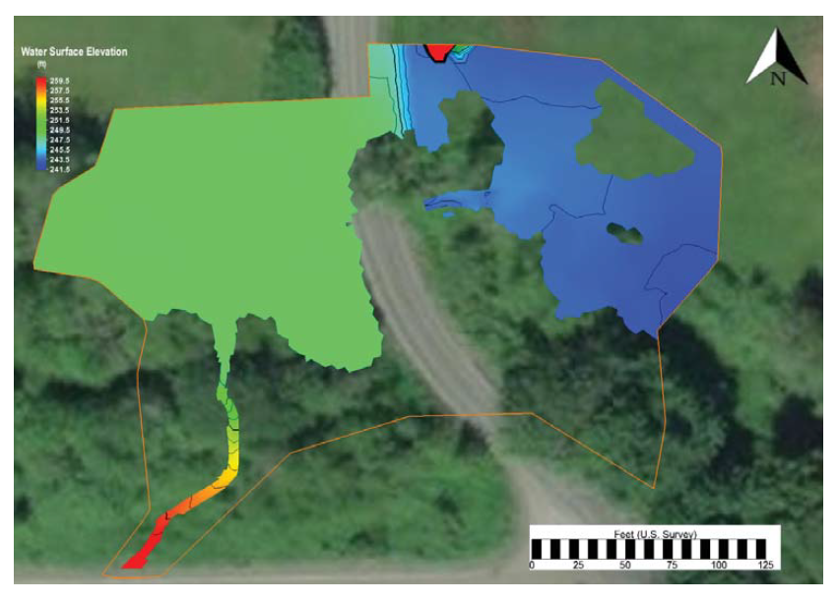
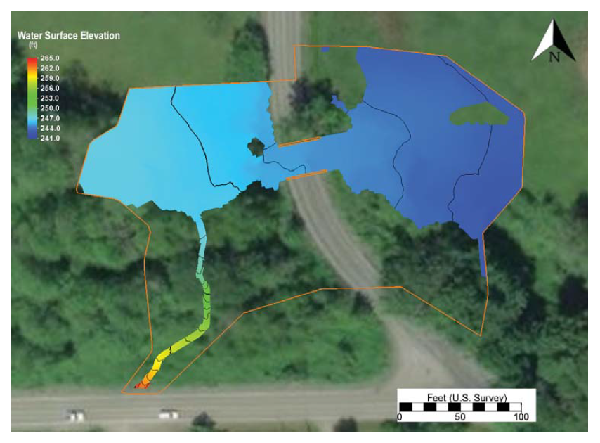
Challenge 2 – Hydraulic Impacts from Undersized Culverts to Larger Fish Passable Structures
(Source: WSDOT)

Slide 17
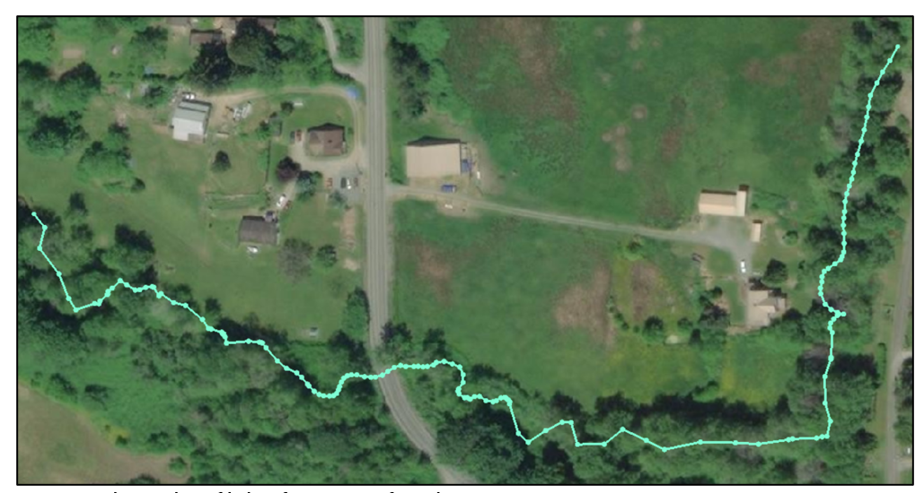
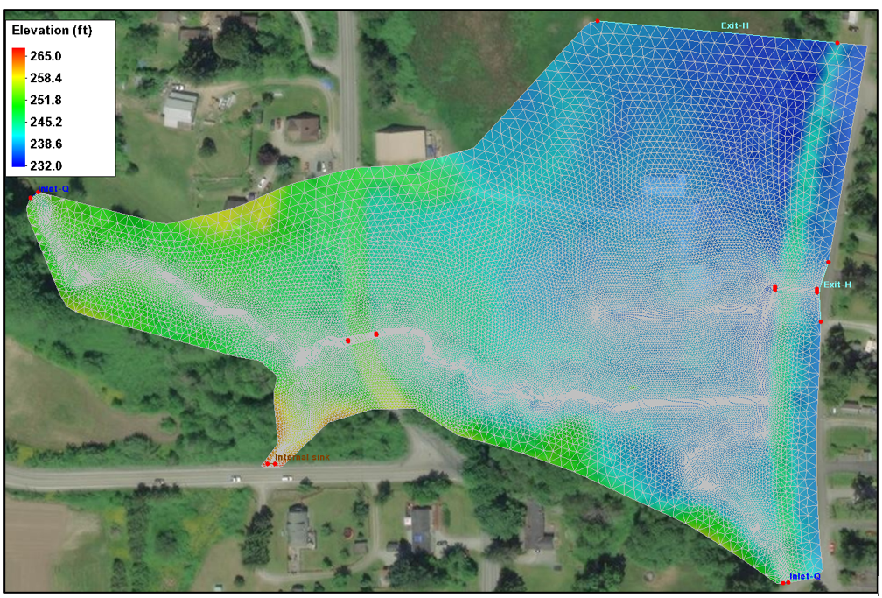
Challenge 2 – Hydraulic Impacts from Undersized Culverts to Larger Fish Passable Structures
(Source: WSDOT)

Slide 18
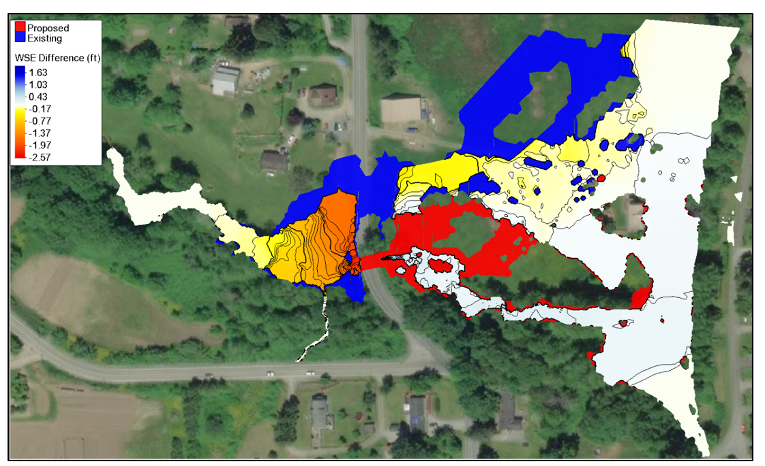
Challenge 2 – Hydraulic Impacts from Undersized Culverts to Larger Fish Passable Structures
(Source: WEST)

Slide 19
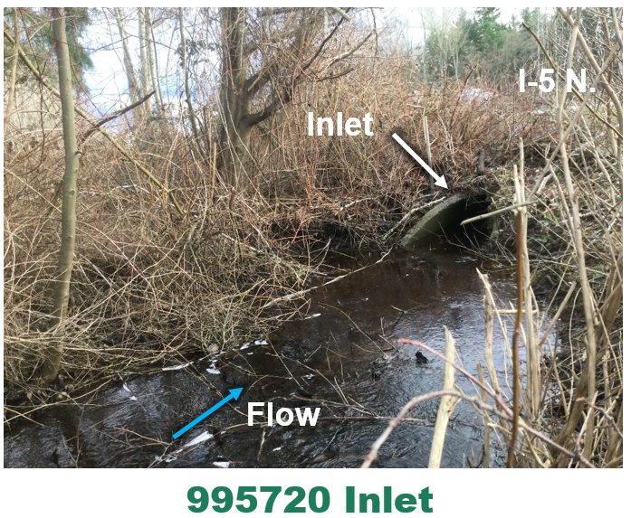
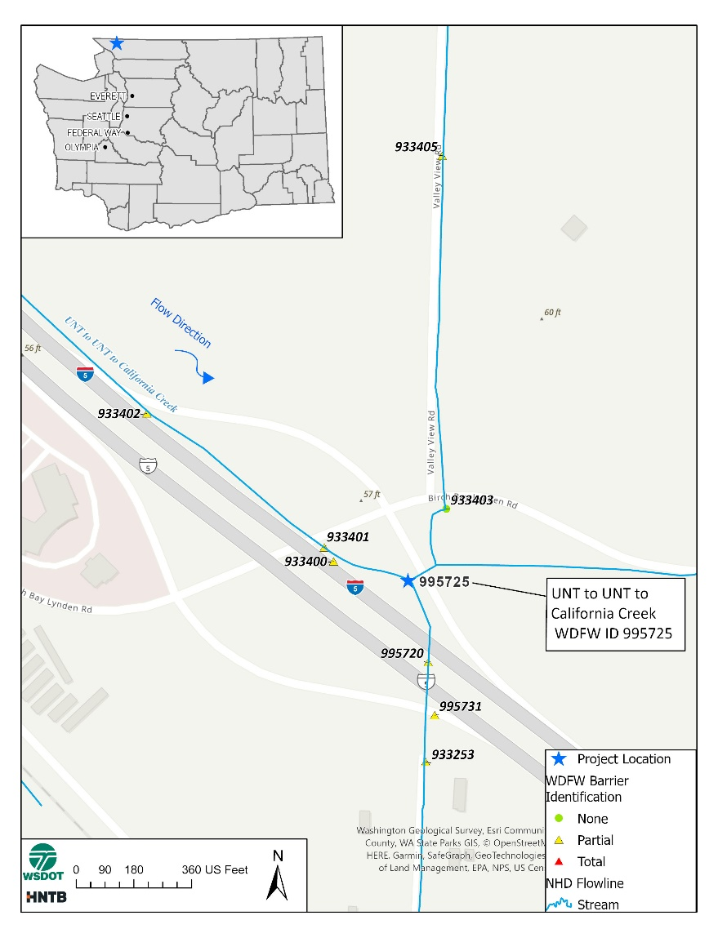
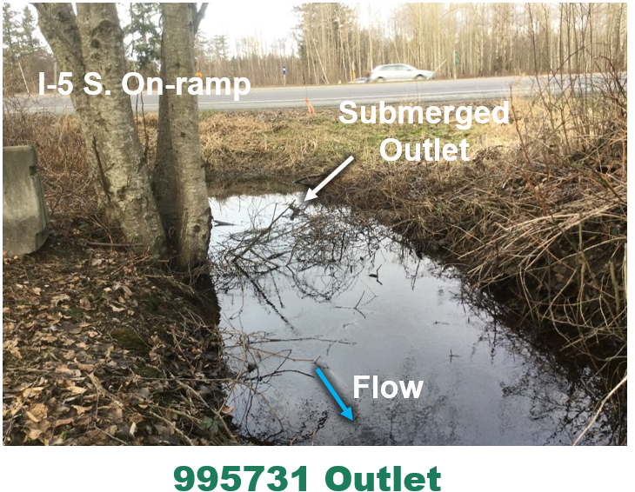
Challenge 2 – Hydraulic Impacts from Undersized Culverts to Larger Fish Passable Structures
(Source: Anchor)

Slide 20
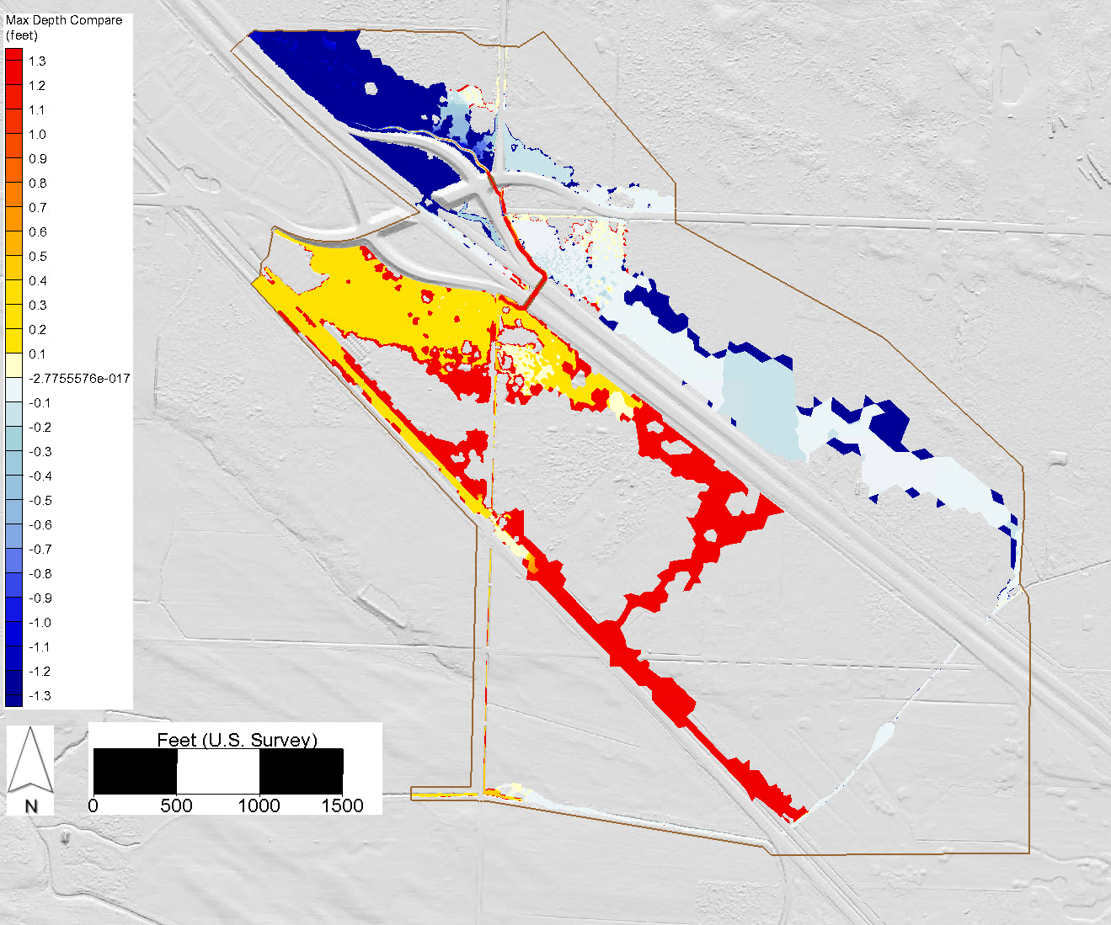
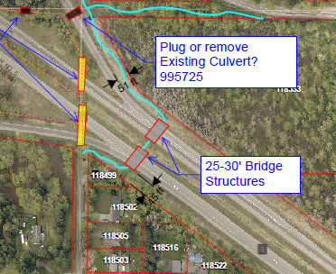
Challenge 2 – Hydraulic Impacts from Undersized Culverts to Larger Fish Passable Structures
(Source: Anchor)

Slide 21
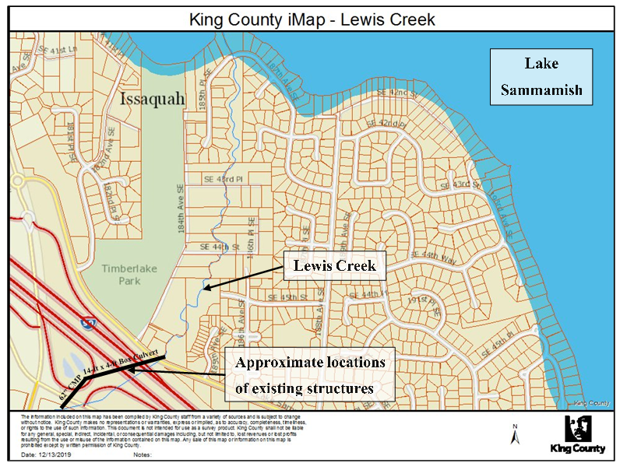
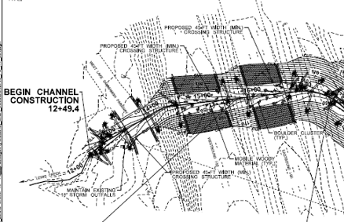
Challenge 3 – Interpretation of Local Code
(Source: WSDOT)

Slide 22
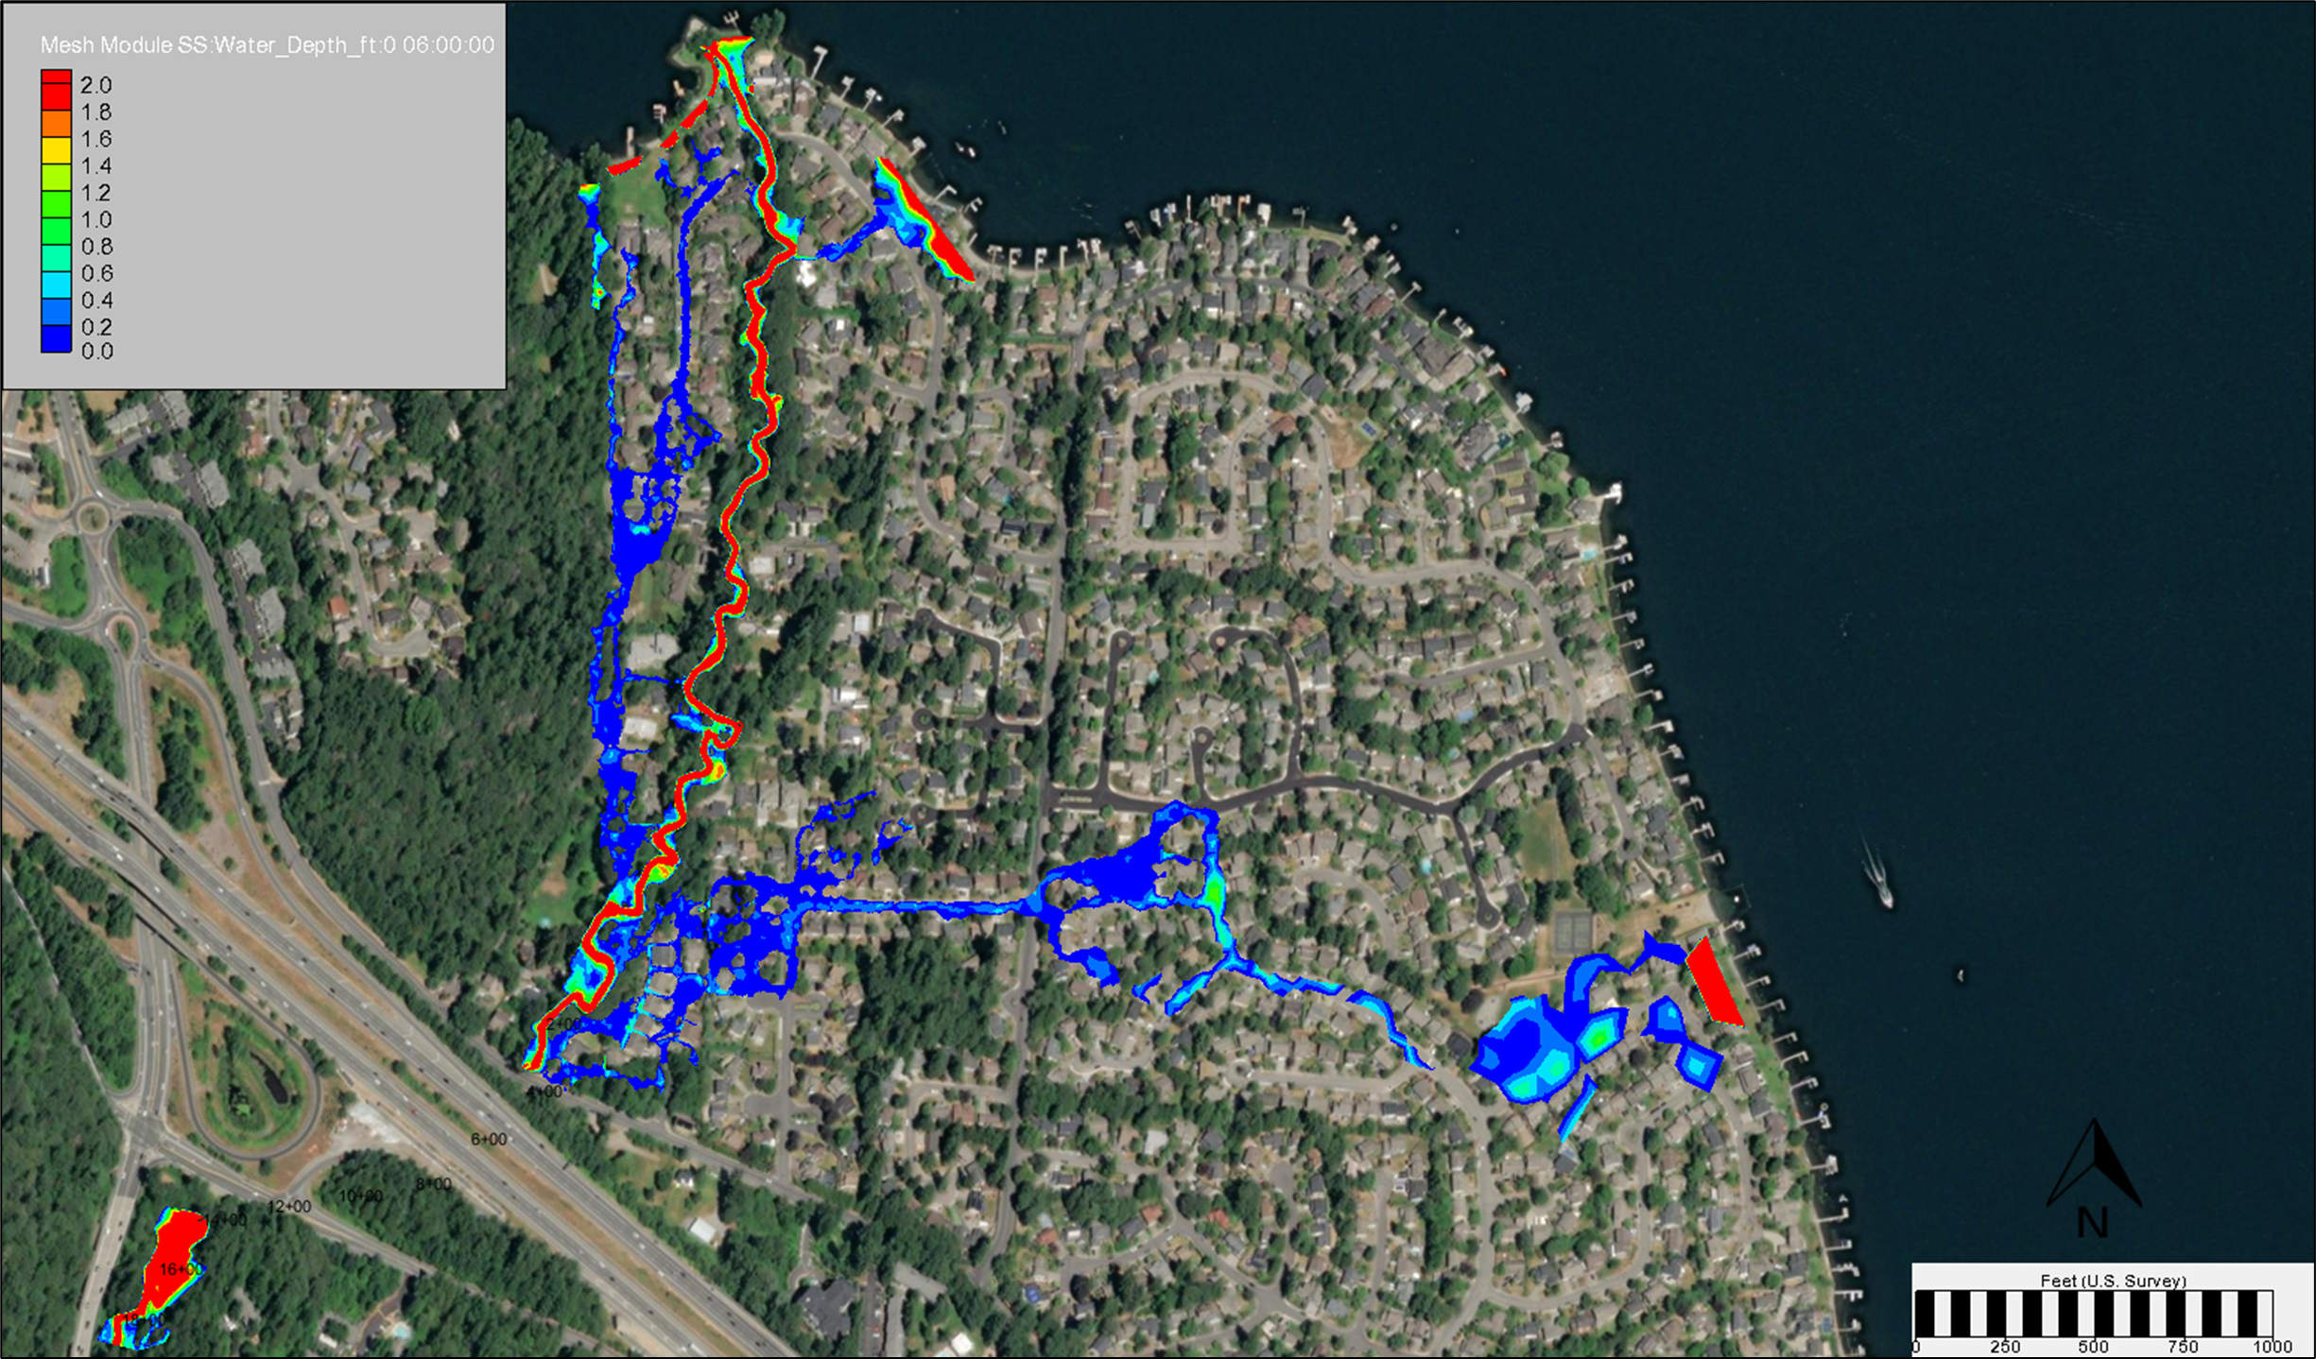
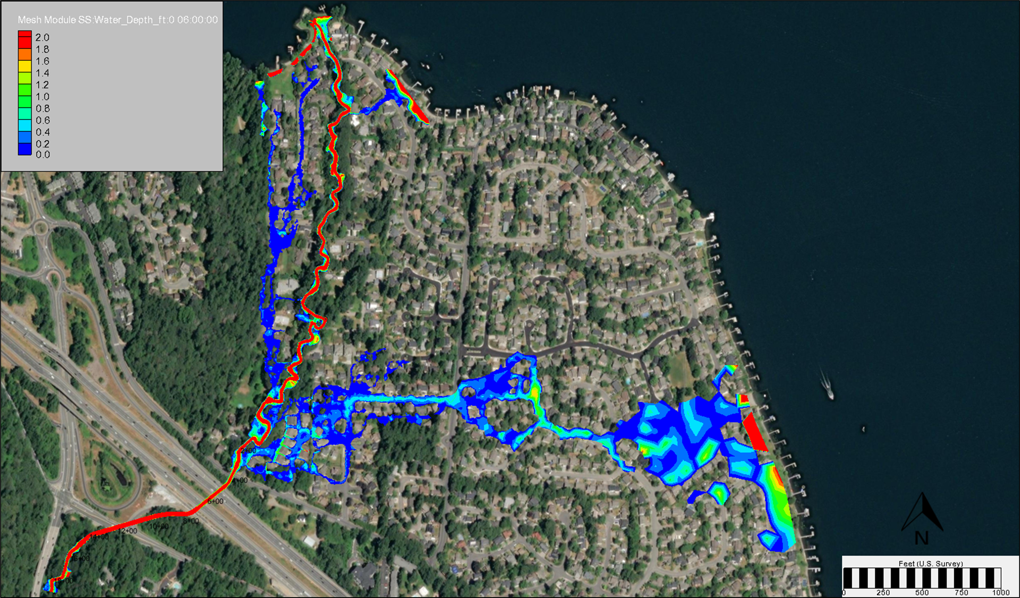
Challenge 3 – Interpretation of Local Code
(Source: GeoEngineers)

Slide 23
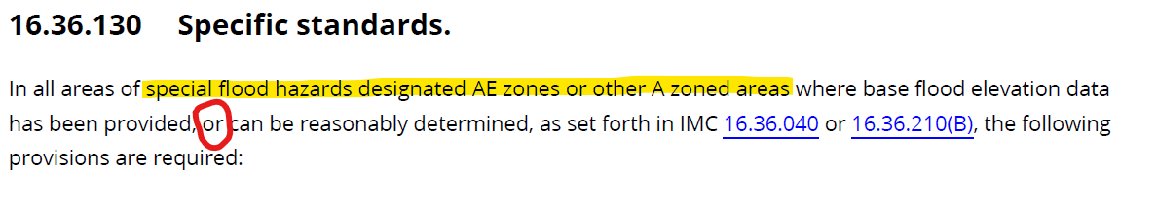
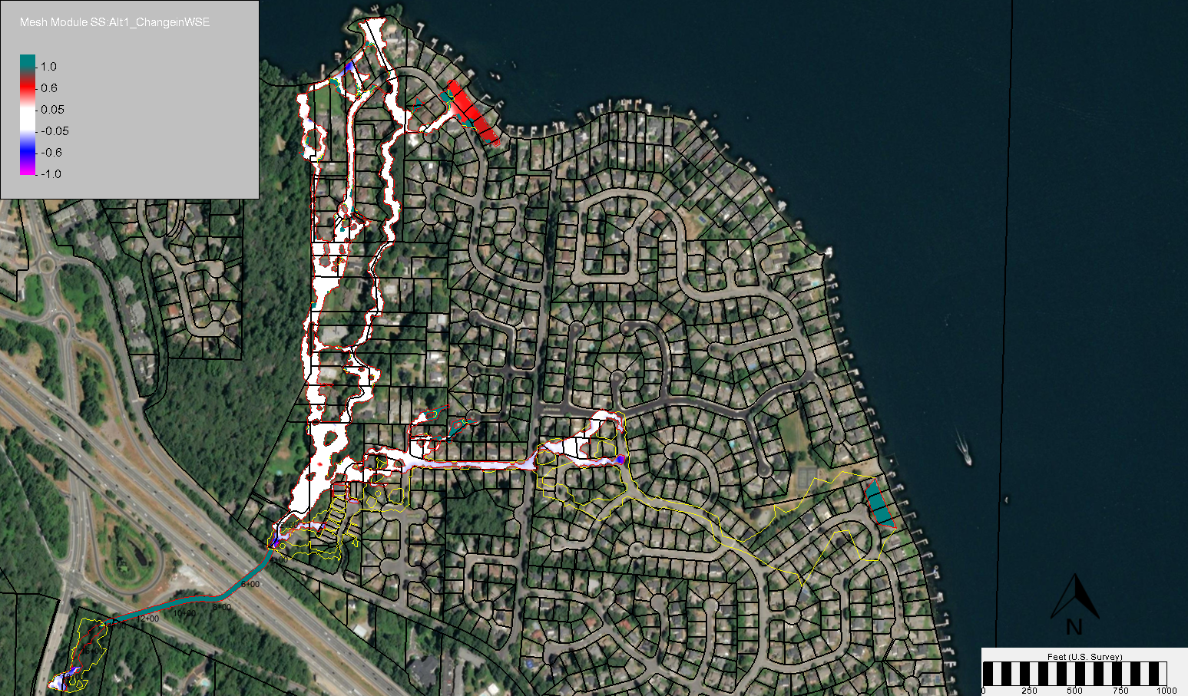
Challenge 3 – Interpretation of Local Code
(Figure Source: GeoEngineers)

Slide 24
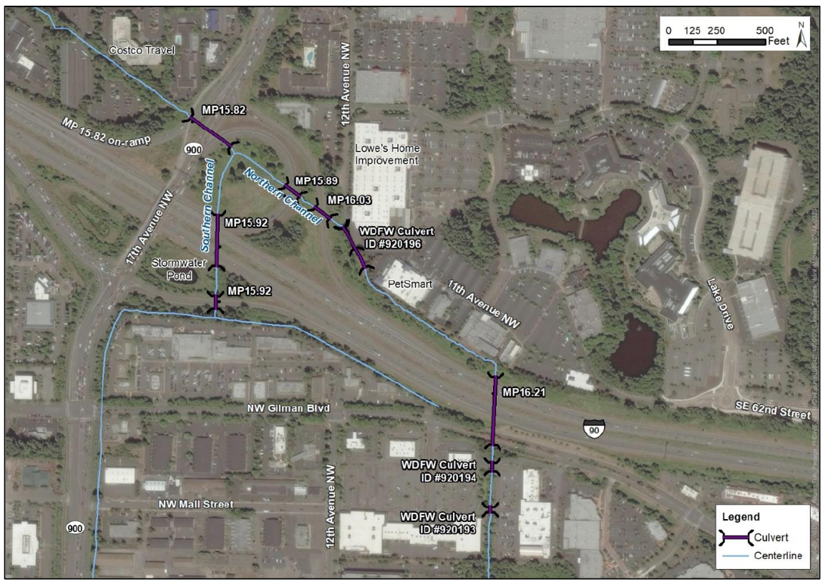
Challenge 4 – Incomplete SFHA
(Figure Source: WSDOT)

Slide 25
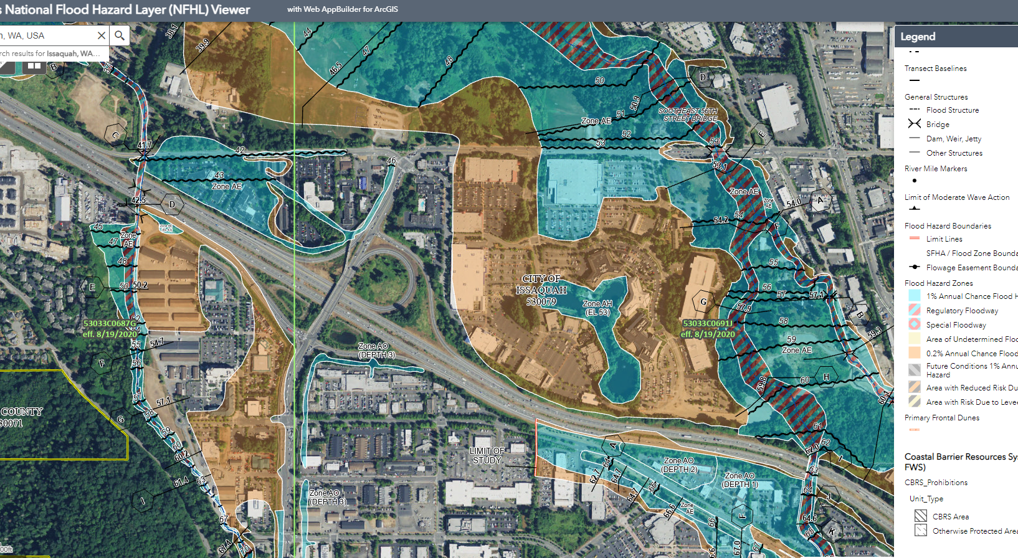
Challenge 4 – Incomplete SFHA

Slide 26
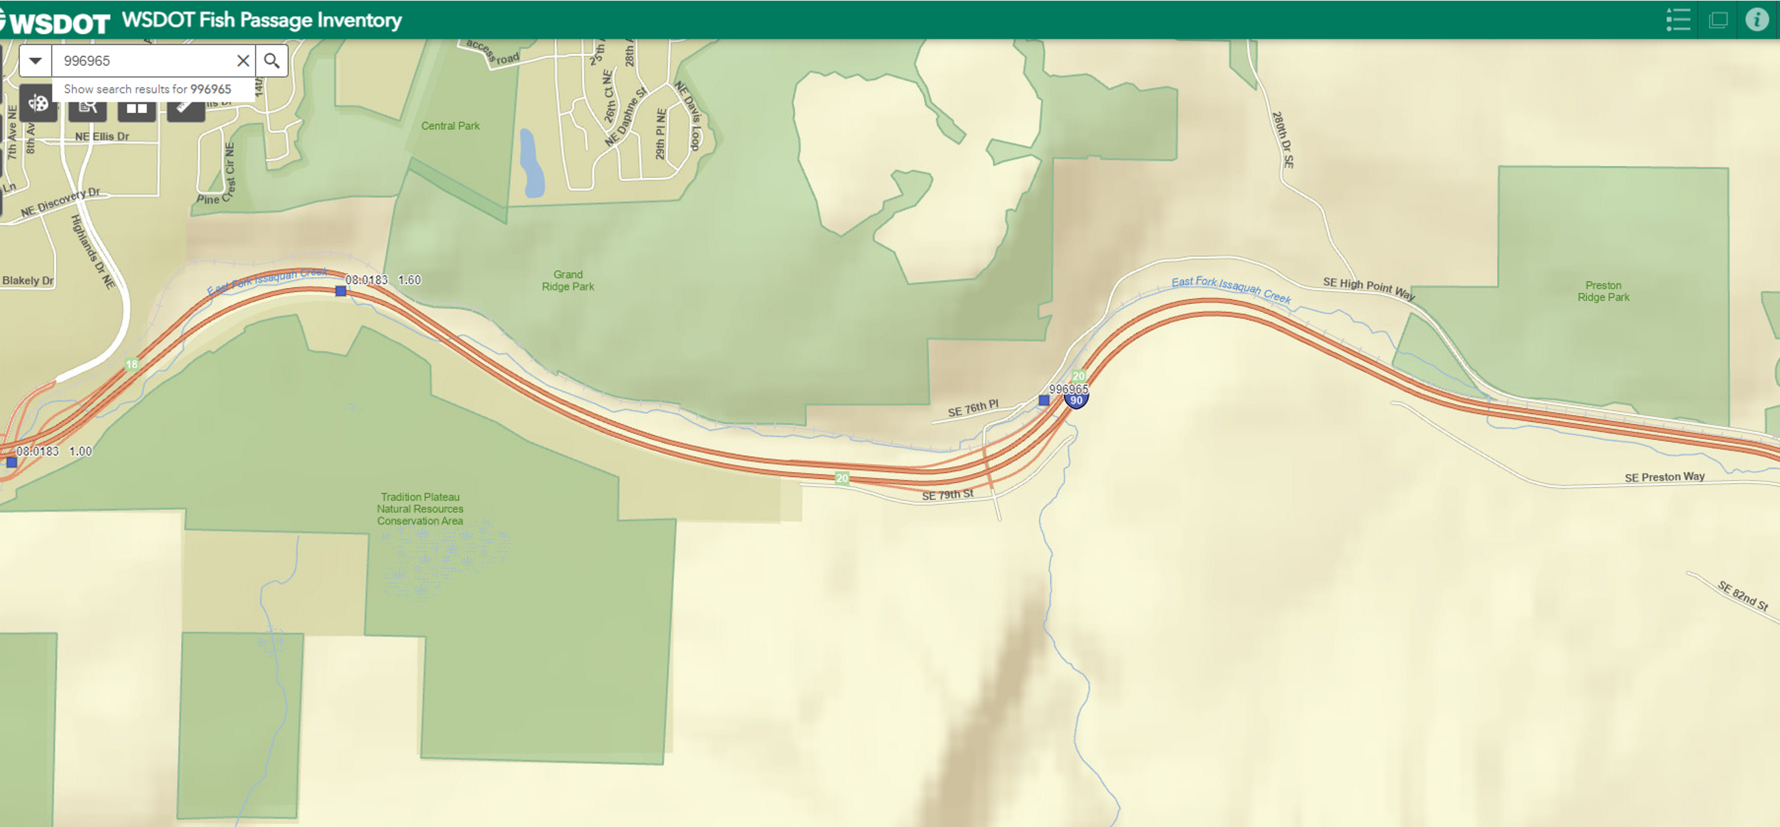
Challenge 5 – Higher Local Standards

Slide 27
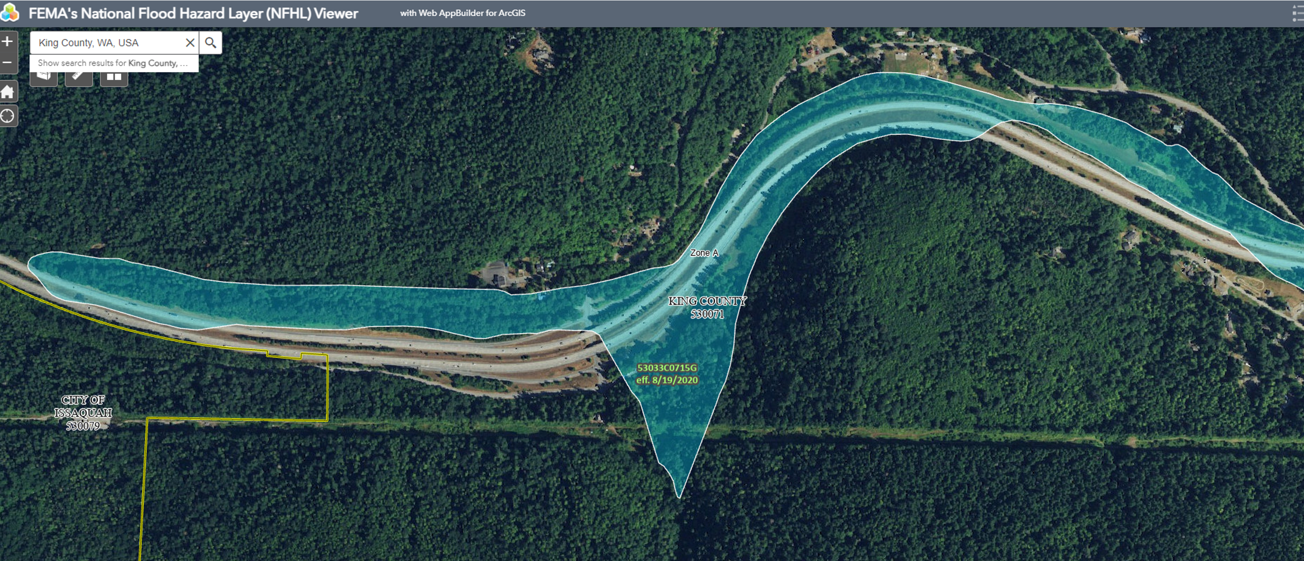
Challenge 5 – Higher Local Standards

Slide 28
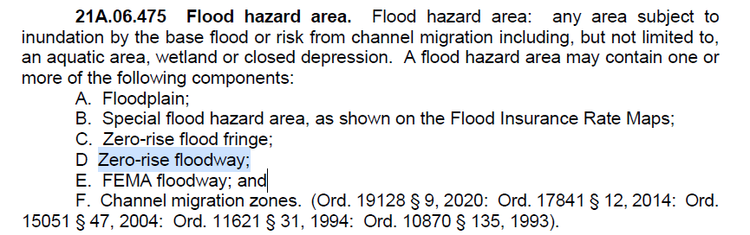
Challenge 5 – Higher Local Standards

Slide 29
Challenge 5 – Higher Local Standards

Slide 30
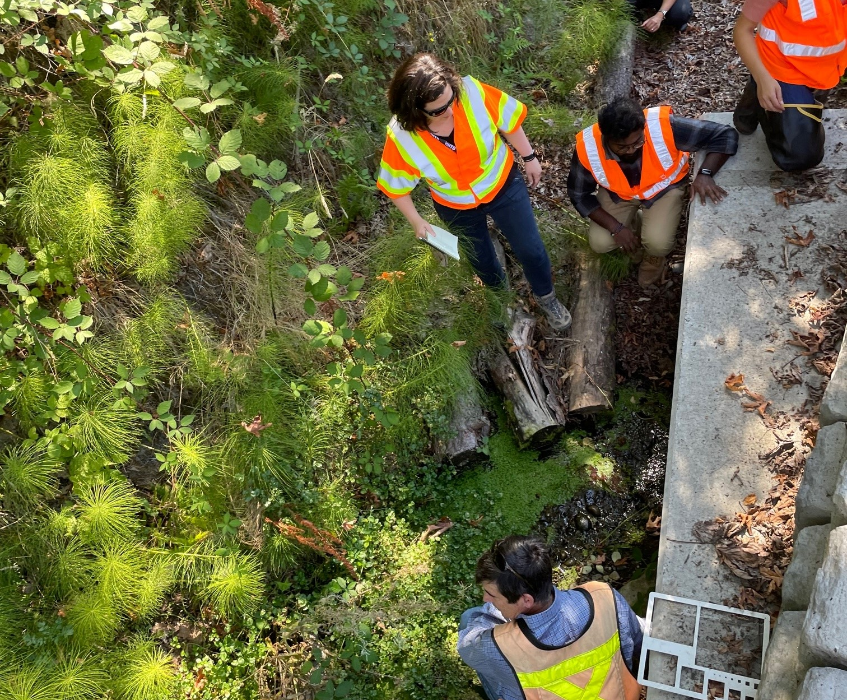
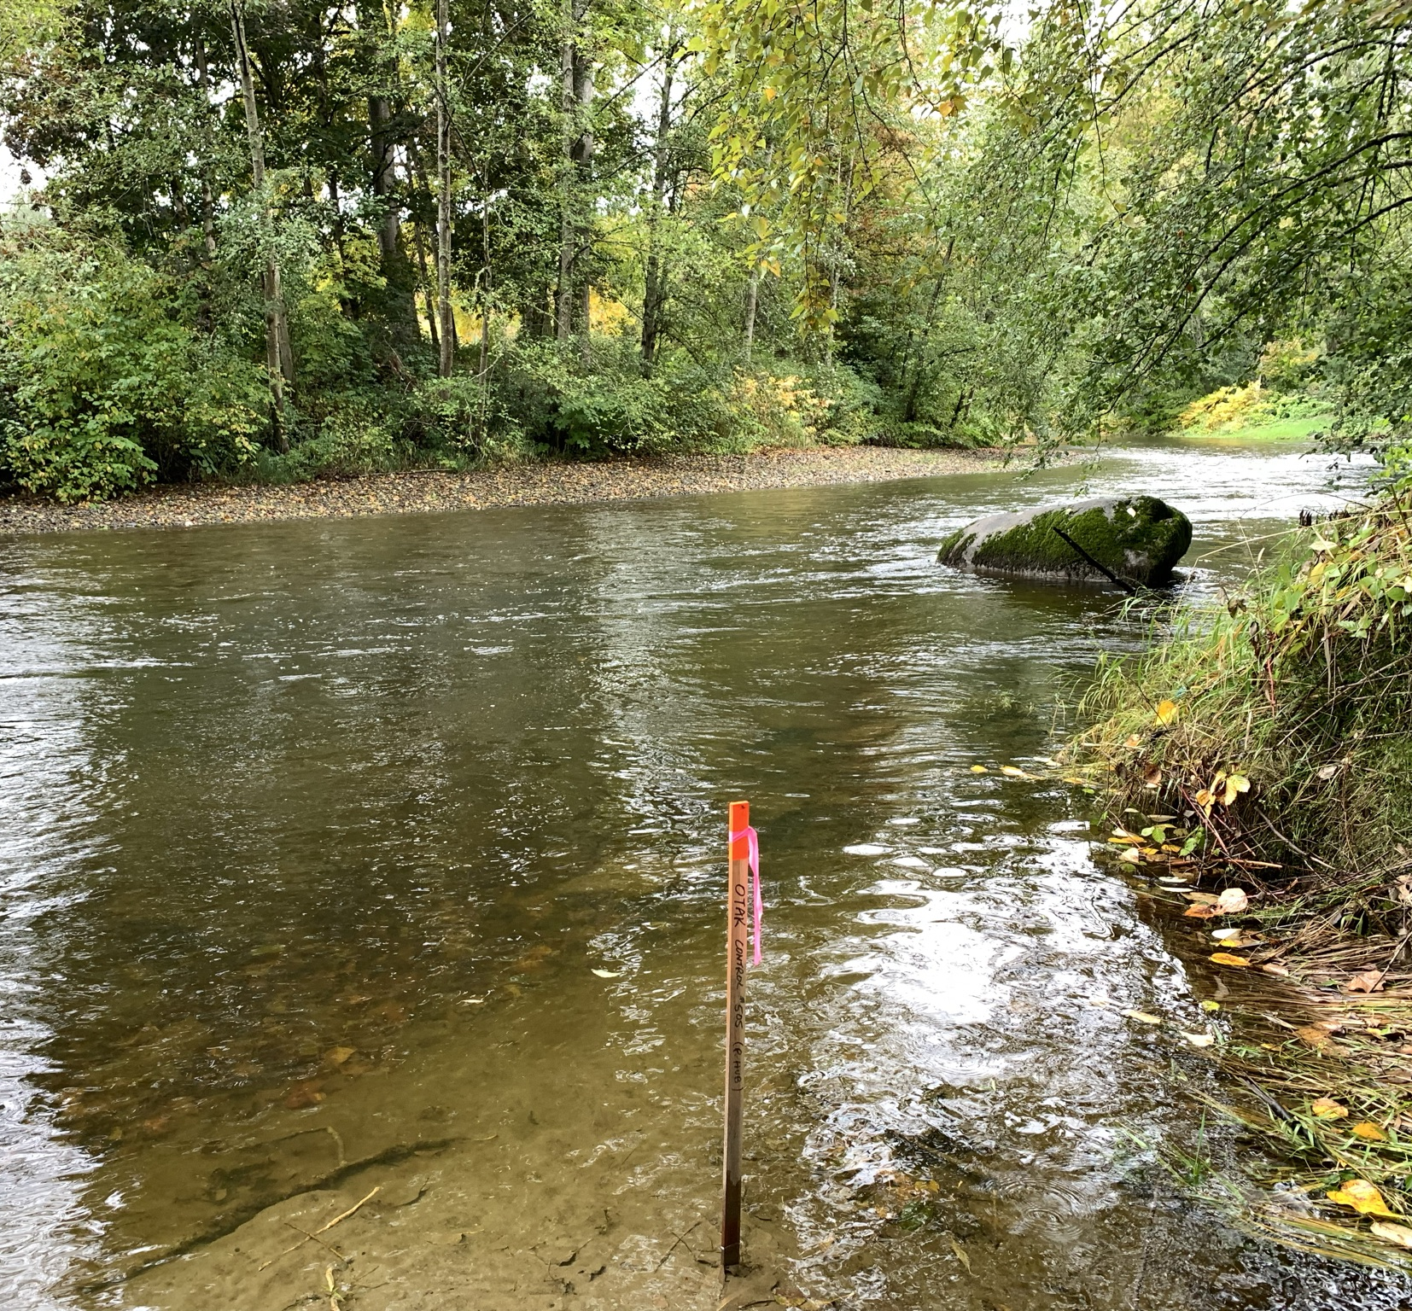
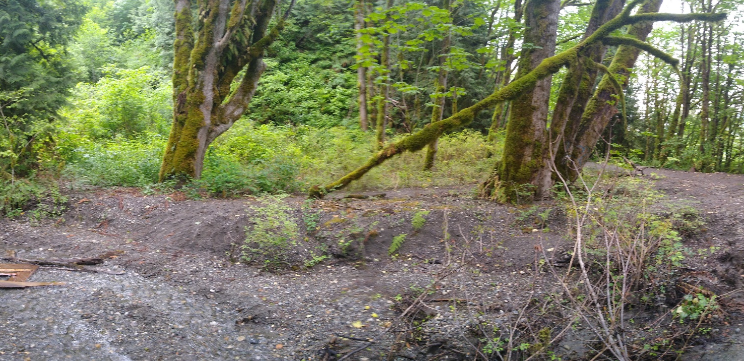
Acknowledgement:
WSDOT HQ Hydraulics
Northwest Region GEC
Questions
Contact:
Julie Heilman Henry Hu
Julie.heilman@wsdot.wa.gov hahu@hntb.com
509.969.3223 425.457.9397
WSDOT HNTB
Olympia, WA Seattle (Bellevue), WA

